Slide 1
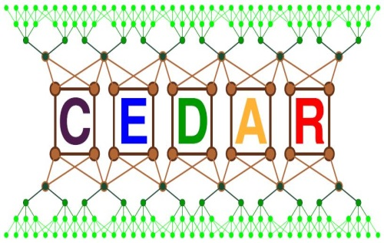
Experimental Track – Research and Development

Slide 2
Outline
A Brief Overview of the Experimental Track
Phase I – The Imitation Game
Phase II – Can we make the world better?

Slide 3
Outline
A Brief Overview of the Experimental Track
Phase I – The Imitation Game
Phase II – Can we make the world better?

Slide 4
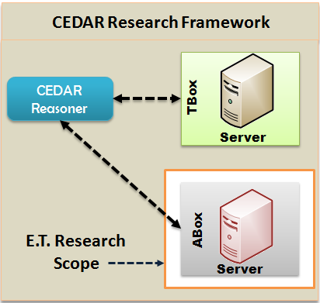
An Overview of the Experimental Track - Objectives
The objectives of the experimental track are twofold:
Conduct an experimental study with scalable and distributed triplestores to replicate the results and compare their performance.
Use the “lessons of experience” for producing effective and efficient solutions.

Slide 5
An Overview of the Experimental Track – Basic Concepts
Resource Description Framework
It is the foundation of defining the data structure for the Semantic Web (SW).
It defines data in the form of <subject, predicate, object>.
A collection of RDF data forms directed, labeled graph.
Blinked Data
It is a special type of data which is a combination of the two most recent notions Big and Linked data.
Triplestore
A triplestore is a purpose-built database for the storage and retrieval of triples.
CEDAR
fundedBy
ANR
rdf:type
PROJECT

Slide 6
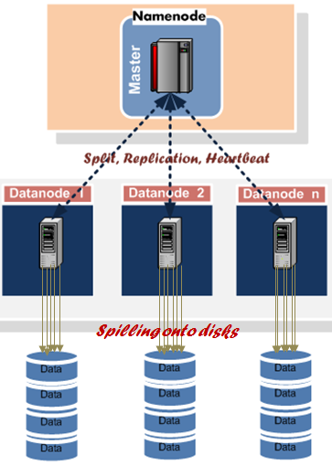
An Overview of the Experimental Track - Basic Concepts
SPARQL
SPARQL is a query language for retrieving and manipulating RDF databases.
Hadoop/MapReduce
A de facto framework for building scalable and distributed applications for storing and processing Big Data on clusters of commodity hardware.
The core of the framework is Hadoop Distributed File System (HDFS) and it relies on MapReduce programming paradigm.
Benchmarking Tool
It facilitates the evaluation of triplestore with respect to queries.
The Architecture of Hadoop

Slide 7
An Overview of the Experimental Track – Key People
Lead Researcher
Prof. Mohand-Saïd Hacid
Manager/Researcher/Developer
Rafiqul Haque
Lead Developers
Minwei CHEN (CedTMart)
Tanguy Raynaud (CedCom)
Mohammed Ali Hammal (Xadoop)
Third Party Service Provider
Laurent Pouilloux (Grid5000, École Normale Supérieure, Lyon)
Vincent Hurtevent (LIRIS Cloud, Université Claude Bernard Lyon 1, Lyon)
Research Chair
Prof. Hassan Aït-kaci

Slide 8
Outline
A Brief Overview of the Experimental Track
Phase I – The Imitation Game
Experiments with Triplestores
Large-scale Triplestores
Experiment Platform
Experiment Setting
Results
Lessons Learnt

Slide 9
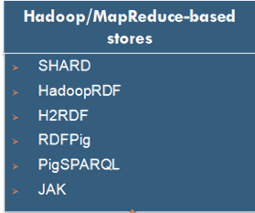
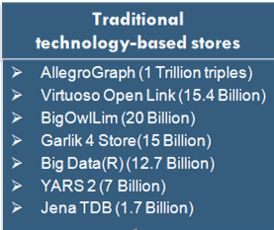
Experiments with Triplestores – Large-scale Triplestores
Easily scalable
Fault-tolerance is guaranteed
Performance (recorded through benchmark) is satisfactory
They are prototypes/PoC
Scalability can be a challenge
Fault-tolerance cannot be guaranteed
Performance (recorded through benchmark) is satisfactory
Some are commercially successful

Slide 10
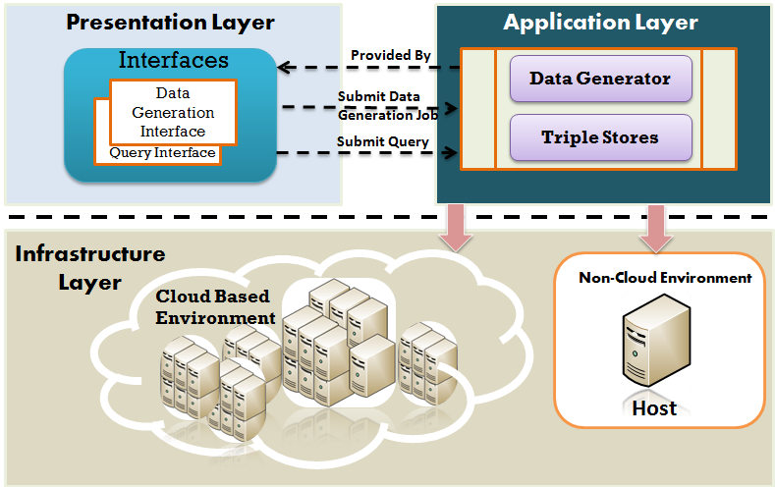
Experiments with Triplestores – Experiment Platform

Slide 11
Experiments with Triplestores – Experiment Setting
Triplestores
SHARD (Scalable, High-Performance, Robust and Distributed)
Developed by the BBN technologies
SHARD saves intermediate results of the query processing to speed up the processing of similar later queries
RDFPig
Developed jointly by VUA and Yahoo
It relies on “Skew-resistant” optimization technique
LUBM
A benchmarking tool to facilitate the evaluation of triplestore with respect to extensional queries.
Queries
14 SPARQL queries suggested by LUBM
Dataset
20 Gigabytes

Slide 12
Experiments with Triplestores – Experiment Setting
Hardware Specification for Node X
Processor: Intel(R) Core I3, 3.20 Ghz, 64 bit
OS: Ubuntu 12.04, 64 bit
HDD: 1 TB SATA
Memory: 8 GB
Hardware Specification for node Y
Processor: Intel(R) Quad Core (TM) I5, CPU 2.70 Ghz 64 bit
OS: Ubuntu 12.04, 64 bit
HDD: 300 GB SATA
Memory: 16 GB
Hardware Specification for nodes in distributed cluster
Processor: Intel(R) Dual Core (TM) I5, CPU 2.20 Ghz 64 bit
OS: Ubuntu 12.04, 64 bit
HDD: 500 GB SATA
Memory: 8 GB

Slide 13
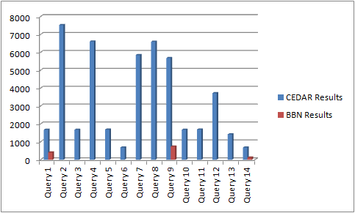
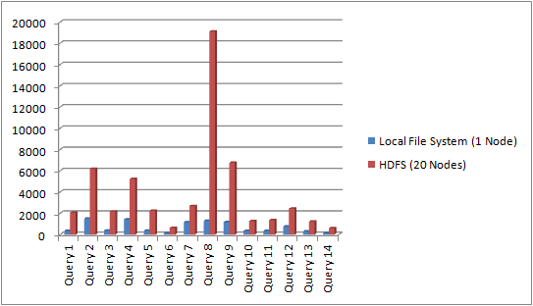
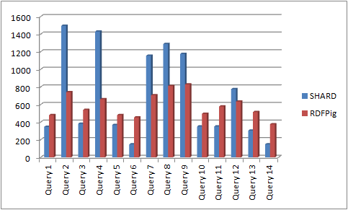
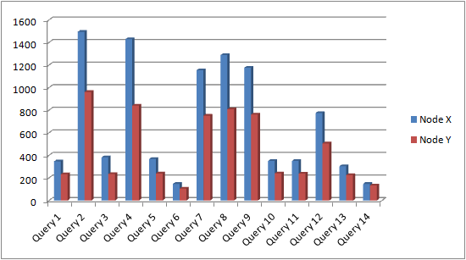
Experiments with Triplestores – Experiment Setting
SHARD Triplestore
800 Million Triples
SHARD Triplestore
20 GB Dataset
Times (in Seconds)
20 GB Dataset
SHARD Triplestore
20 GB Dataset
Notes:
Various factors influence the performance of triplestores.

Slide 14
Experiments with Triplestores – Lessons Learnt
Replication of results – Myth or Real?
The performance of triplestores depends on several issues:
Efficient data partition
Distribution of data within clusters
Efficient query plans
Hardware specification
Size of main memory
HDD RPM
Clock cycle time
According to our cost model, performance is the most challenging issue for Big Data processing applications.

Slide 15
Experiments with Triplestores – Lessons Learnt (cont.)
The insight of Hadoop/MapReduce
It guarantees scalability for Big Linked Data applications
It has almost 150 configuration parameters. Therefore, configuring a high-performance Hadoop cluster is highly challenging
The performance tuning parameters are heavily dependent on each other
At runtime, failure of slave nodes affects application performance
The overhead cost affect performance
The delay time between map→sort→reduce can affect the performance severely
The creators were friendly but not always responsive.
Hadoop/MapReduce can be an ideal framework for building analytics with batch processing style. However, it is not ideal technology for a real-time analytic.

Slide 16
Outline
Phase II – Can we make the world better?
An Overview of CedTMart Triplestore
The Architecture
CedTMart Components
Query Optimization
Conclusion and Future Work
Demonstration
Implementation Credit: The main implementer of CedTMart is Minwei Chen, M.Sc.

Slide 17
An Overview of CedTMart
CedTMart is a framework for processing Big Linked Data and queries in both centralized and distributed environment.
The main goal of this framework is to guarantee the scalability and high-performance in processing queries on large-scale datasets.
The key functions of this framework are: data cleaning, conversion, compression, comparison, distribution, and query processing.

Slide 18
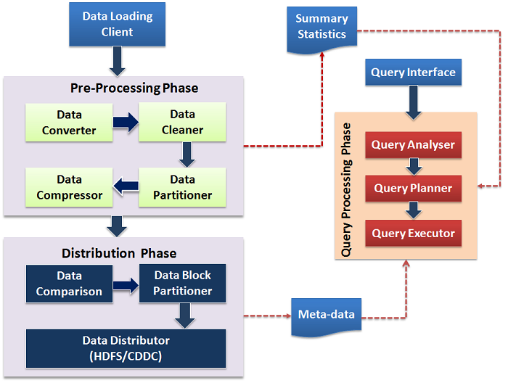
The Architecture

Slide 19
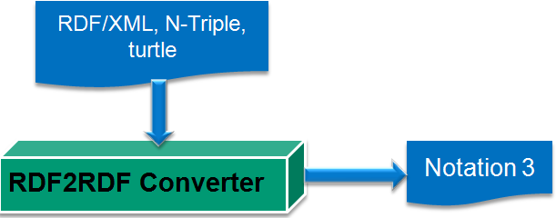
CedTMart Components – Data Converter
CedTMart is compatible with Notation 3 (N3) RDF data format.
The converter converts any RDF serialization format to N3.
RDF2RDF Library
Developed By: Enrico Minach
Link: http://www.l3s.de/~minack/rdf2rdf/

Slide 20
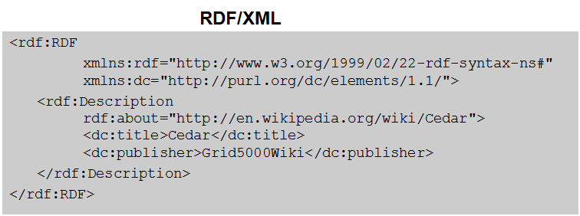
CedTMart Components – Data Converter
Converted to

Slide 21
CedTMart Components –Data Cleaner
Data cleaning is carried out in two steps:
Validate triples
Separate invalid triples
It mainly relies on syntactic rules of RDF recommended by W3C.
Rule based
Validator
Invalid Triple
Separator
<> a owl:Ontology .
<> owl:imports < htt://www.lehigh.edu/%7Ezhp2/2004/0401/univ- bench.owl> .
Example of invalid triples

Slide 22
CedTMart Components – Data Partitioner
Data Partitioner performs two different types of partitioning
Predicate Partitioning (PP)
Splitting triples by predicate
It is a kind of predicate indexing
Predicate Object Partitioning (POP)
Splitting triples by predicate-object of type
It is a kind of type indexing
In real world RDF datasets, the number of predicate is no more than 10 or 20 (M. Socker et al., 2008)

Slide 23
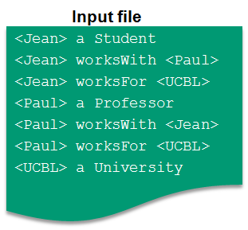
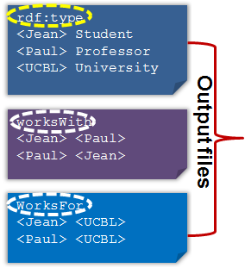
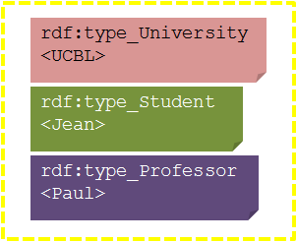
CedTMart Components –Data Partitioner
Predicate
Object
Partition
Predicate
Partition
Predicate
Partitioner
Predicate
Object
Partitioner
Data Reader

Slide 24
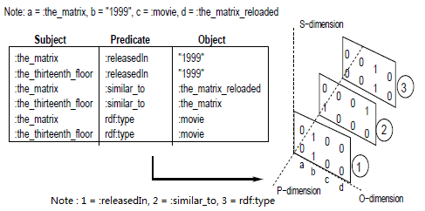
CedTMart Components –Data Compressor
Example of BitMat Representation
Mapping Triples to Bit Matrix (BitMat)
S-O and O-S BitMat Tables of PP
Index Table
Id | Data
(Integer) | (String)
Our idea
BitMat (M. Atre, 2009)

Slide 25
CedTMart Components –Data Compressor
D-Gap Compression
It is a process to translating a bit array into a structure using integer.
It is a special type of Run Length Encoding (RLE) method.
The key purpose is to compress the sparse BitMat matrices and enable the system to load the S-O (Subject-Object) and O-S (Object-Subject) matrices onto the main memory which helps processing queries faster.
It enables performing logical operations such as processing queries directly on the compressed files.

Slide 26
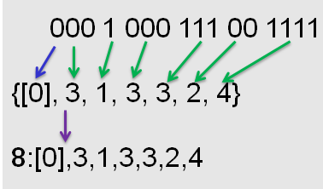
CedTMart Components –Data Compressor
The objective is to load compressed data instead of loading a huge binary sequence.
D-Gap Compression Process
It starts with the Start Bit whose binary sequence is always either 1 or 0.
Then, the length of the binary sequence of equal bits is counted.
The total length is calculated by summing the length of equal bits.

Slide 27
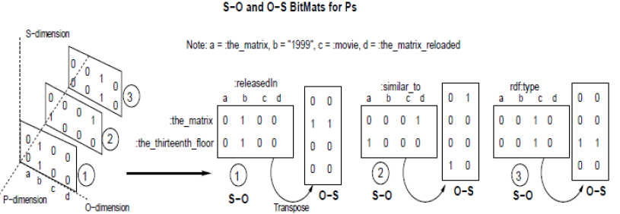
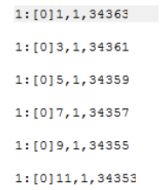
CedTMart Components –Data Compressor
BitMat S-O and O-S matrices
Index
Compressed
Predicate: S-O Matrix
Compressed Predicate: O-S Matrix
The data compression
process example.

Slide 28
CedTMart Components – Data Distributor
Data distributor performs two functions:
Data Comparison
The key purpose is to partition dataset intelligently to reduce communication between data nodes.
It is a process of comparing subject-object pairs between the predicates.
It calculates similarity between predicates by summing the common distinct subjects and objects between two predicates.
Data Distribution
It distributes data within a cluster of nodes.

Slide 29
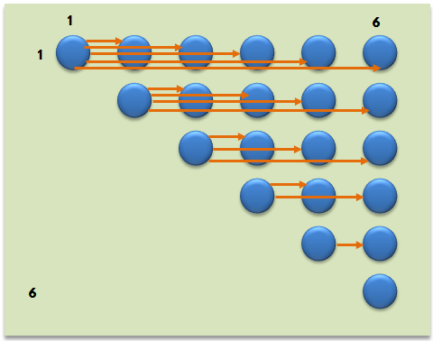
CedTMart Components – Data Distributor
P1
S₁ | O₁₃
S₂ | O₂₈
S₃ | O₃
S₄ | O₄₄
S₅ | O₅₀
P2
S₁ | O₂₈
S₂₇ | O₂₈
S₃₁ | O₃₁
S₄ | O₄
P3
S₁₅ | O₁₅
S₂₁ | O₂₁
S₃₃ | O₃₃
S₄₀ | O₄₀
P4
S₁₁ | O₁₁
S₂ | O₁₂
S₂ | O₃₉
S₄ | O₄₀
P5
S₁₈ | O₁₈
S₂ | O₁₈
S₃ | O₃
S₄ | O₄
P6
S₁ | O₁
S₂₆ | O₂₆
S₅₃ | O₅₃
S₄ | O₄
S₃₃ | O₃₉
S₂₁ | O₂₁
S₃₃ | O₃₃
S₂₈ | O₂₈
P1 ∩ P2 → RS or ∅
P1 ∩ P3 → RS or ∅
P1 ∩ P4 → RS or ∅
P1 ∩ P5 → RS or ∅
P1 ∩ P6 → RS or ∅
P2 ∩ P3 → RS or ∅
P2 ∩ P4 → RS or ∅
P2 ∩ P5 → RS or ∅
P2 ∩ P6 → RS or ∅
P3 ∩ P4 → RS or ∅
P3 ∩ P5 → RS or ∅
P3 ∩ P6 → RS or ∅
P4 ∩ P5 → RS or ∅
P4 ∩ P6 → RS or ∅
P5 ∩ P6 → RS or ∅
Predicate Comparison Process

Slide 30
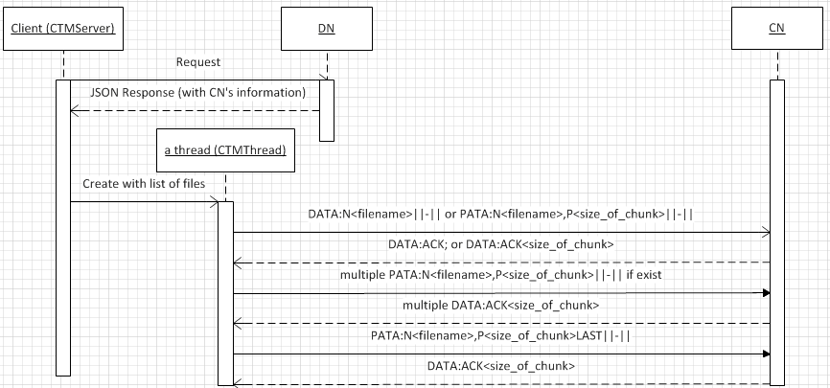
CedTMart Components – Data Distributor
DN : Directory Node
CN: Computer Node
Data Distribution Protocol

Slide 31
CedTMart Components – Query Processor
The query processor is composed of three components:
Query analyser
Performs analysis
Measure the complexity of queries
Query Planner
Partitions SPARQL graphs
Ranks subgraphs
Calculate costs
Generates an efficient plan based on the cost of executing subgraphs (parts of a query)
Query executor
Executes subgraphs

Slide 32
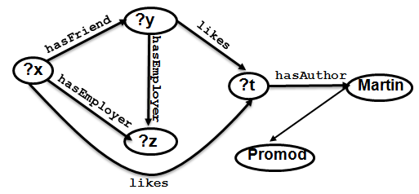
CedTMart Components – Query Processor
SELECT ?x WHERE
{
?x hasFriend ?y.
?x hasEmployer ?z.
?y hasEmployer ?z.
?x likes ?t.
?y likes ?t.
?t hasAuthor Martin.
Promod hasFriend Martin
}
Clause
Query
form
Result
variable
SPARQL Query expressed in the form of
Graph.
Triple Patterns
Pattern variable
Example of a SPARQL Query

Slide 33
CedTMart Components – Query Processor
Query Analysis
number of query forms,
type of query form,
number of result variables,
type of result variable,
number of triple patterns,
number of variables contained in each triple pattern,
number of modifiers,
number of global joins,
availability of data set definition,
availability of query pattern,
availability of modifier.
SELECT ?x WHERE
{
?x hasFriend ?y.
?x hasEmployer ?z.
?y hasEmployer ?z.
?x likes ?t.
?y likes ?t.
?t hasAuthor Martin.
Promod hasFriend Martin
}
Summary of Analysis
Query form: 1
Result Variable: 1
Triple Pattern: 7
Pattern Variable: 4
Global Join: 6
Modifier: 0

Slide 34
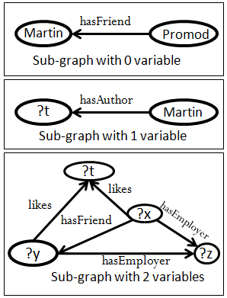
CedTMart Components – Query Processor
Query Planning
SPARQL Graph Partitioning
It is a process of decomposing a SPARQL graphs (queries) into subgraphs (sub-queries) by number of variables contained in triple patterns.
The is to increase parallelization and increase the speed of processing queries.

Slide 35
CedTMart Components – Query Processor
Query Planning
SPARQL SubGraph Ranking
It is a process of ordering subgraphs by number of variables contained in triple patterns.
The key purposes is to prioritize the execution sequence, assists in calculating cost, and minimize the number of execution.
QRank
SG1 | 1
SG2 | 2
SG3 | 3

Slide 36
CedTMart Components – Query Processor
Cost calculation
Query processing cost is calculated by summing three cost patterns with their coefficients,
C^{Q} = ∑ (αC^{T} + βC^{P} + γC^{V} )
Where:
C^{T} denotes the cost triple pattern
C^{P} denotes the cost of Predicate
C^{V} denotes the cost Predicate
variables
α, β, γ denote the coefficients whose values depend on the size of preprocessed datasets and nature
of queries

Slide 37
CedTMart Components – Query Processor
Cost of Triple Pattern
It is determined by the number of variables a subgraph contains.
Cost of Predicate
It is determined by the size of predicates and the cost of subject and/or object.
The size of a predicate is determined by the number of subjects and objects contained in a predicate file.
The cost of a subject and an object is determined by the number of entries in S-O and O-S matrix.
Cost of Variable
It is determined by number of times a variable appears in a triple pattern and the total number of variable contained in that triple pattern.
The cost of predicate is another parameter of calculating cost of variables.

Slide 38
CedTMart Components – Query Processor
Generating Execution Plan
The planner generates an efficient execution plan based on the estimated cost.
Query Execution
The executor executes queries according to the generated plan.

Slide 39
Query Optimization
Optimization
Predicate partitioning helps in planning global and local joins efficiently.
Predicate object partition is a type of index which enables generating a highly-efficient plan for a special type of queries.
Intelligent partitioning of data blocks within a cluster can optimize the performance.
Multilevel indexing enables faster information retrieval.
We developed a binary tree structure of block location which enables identify data location faster.
The cost patterns assist in generating efficient query execution plan.
D-Gap compression enables loading a huge index table on memory.

Slide 40
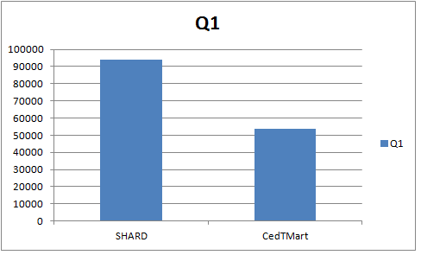
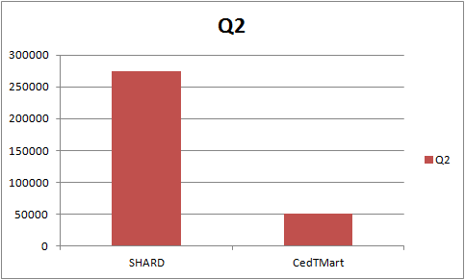
Experiment
Experiment Setting
3–Node Cluster
Dataset: 10 GB LUBM data
Node Specification
Intel Xeon E312xx 8-core Processor
OS: Ubuntu 12.04
Memory: 16 GB
HDD: 15 GB (root disk)
500 GB and 100 GB (Block storage
volumes)
Q1:
SELECT ?X WHERE {?X rdf:type ub:GraduateStudent}
Q2:
SELECT ?X WHERE {?X rdf:type ub:ResearchAssistant. ?X ub:memberOf
http://www.Department0.University3466.edu
}
Times in milliseconds

Slide 41
Conclusion & Future Work
Conclusion
The CedTMart framework provides a complete set of functionalities for processing multi-join queries on Big Linked dataset.
It has been built on various methods and techniques to guarantee high-performance in processing queries.
The cost patterns along with binary tree representation data block locations are efficient techniques for processing queries faster.
The framework is scalable but it needs further investigation.

Slide 42
Conclusion & Future Work
Conclusion
Contribution: experimenting with our own ideas for a distributed triplestore.
The query processor has a few limitations:
It cannot handle all SPARQL query forms.
The compressor is memory bound.
It cannot process modifiers, and optional pattern queries.
The performance of CedTmart in Big Linked Data is not yet guaranteed.
It does not have some important functional features such as Update.

Slide 43
Conclusion & Future Work
Potential Improvements
The data cleaner should be improved by adding more rules.
CedTMart should be experimented in a massive-scale cluster to validate scalability.
The algorithms and optimization techniques should be refined by conducting more experiments with respect to different use cases.
Further research is required to optimize the global join of complex queries.
The source code of triplestore needs debugging.

Slide 44
Demonstration

