Slide 1
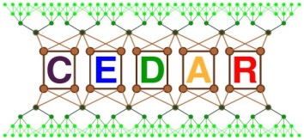
CEDCOM High performance architecture for big data applications Tanguy Raynaud CEDAR Project

Slide 2
Outline
Phase III – In the search of a perfect enabler
Motivation
An Overview of CedCom Architecture
The CedCom Components
Block Management Protocol
Communication Protocol
Demonstration
Conclusion and Future Work
Note: The main implementer of CecCom is Tanguy Raynaud, M.Sc.

Slide 3
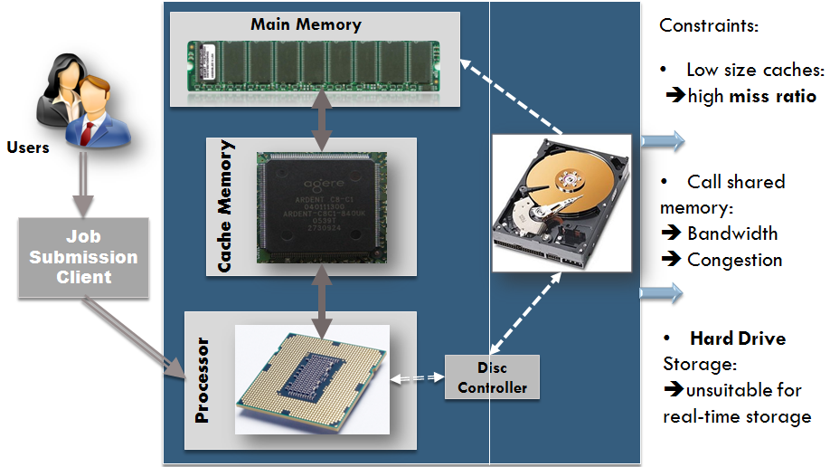
Motivation
The Secondary storage is too far from the processors which turns data access too slow if a cache hit is missed

Slide 4
An Overview of CedCom
CedCom is an architecture which is built on COMA (Cache-Only memory architecture) and some features of Hadoop Distributed File System (HDFS)
COMA is a memory architecture which turns a local memory as a huge dynamic RAM cache called Attraction Memory.
The Hadoop Distributed File System (HDFS) is designed to store very large data sets reliably, and to stream those data sets at high bandwidth to user applications.
CedCom is an architecture without having the notion of home node.

Slide 5
An Overview of CedCom
Our objective is to develop a high-performance and fault-tolerant architecture for Big Data applications by
enabling CPU (Central Processing Unit) accessing data faster
increasing cache hit ratio
managing data replication in an intelligent manner
migrating data and computation on demand between nodes dynamically depending on the context

Slide 6
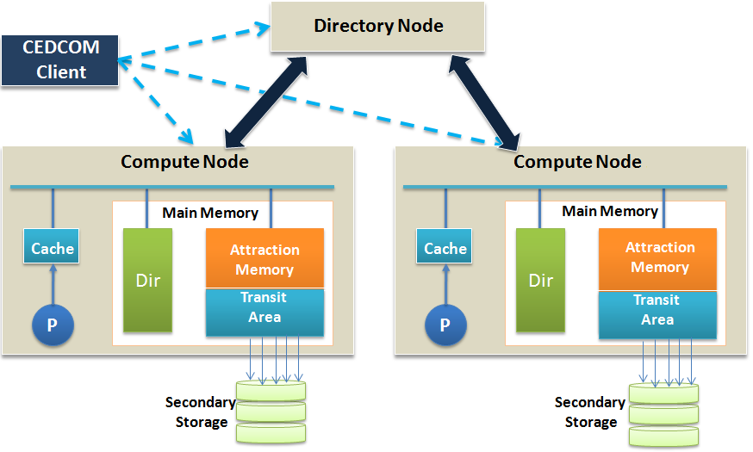
The Architecture of CedCom
Figure: The architecture of CedCom

Slide 7
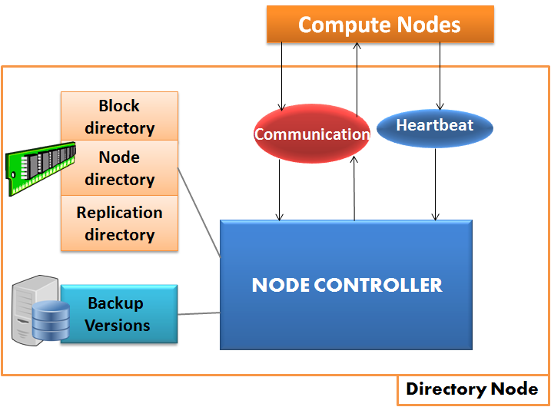
The CedCom Components -Directory Node
Figure: The architecture of a Directory Node

Slide 8
The CedCom Components -Directory Node
The directory node is global meta-data server which provides the information of nodes, replicas, and data blocks.
It consists of a node directory, a block directory, a replication directory and a node controller
Node directory
indexes IP address/node
Block directory
indexes files/data blocks
indexes data blocks/compute node

Slide 9
The CedCom Components -Directory Node
Replication Directory
Save the location of the replications
Request new replications
Reload lost blocks onto memory
It registers compute nodes
It helps in migrating data blocks between compute nodes

Slide 10
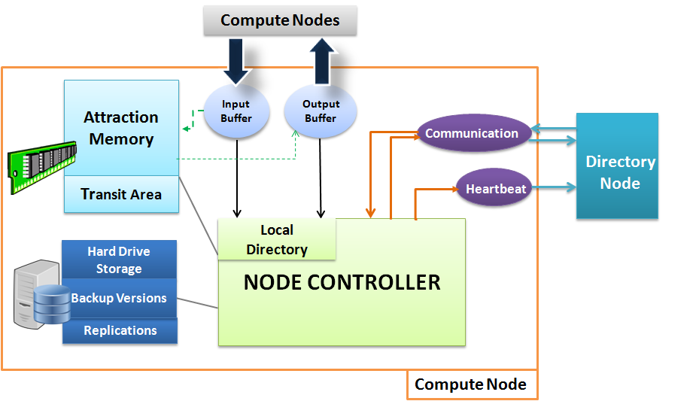
The CedCom Components -Compute Node
Figure: The architecture of a Comute Node

Slide 11
The CedCom Components -Compute Node
A compute node comprises the following components:
Attraction Memory
It stores data using Set Associative Cache (SAC) technique
SAC divides a memory into blocks and uses hash keys to store and find data
Transit Area
It is a special area in main memory which stores the least recently used data blocks
Add a block
B33
Set = 33%4 = 1
Find a block
B22
Set = 22%4 = 2

Slide 12
The CedCom Components -Compute Node
Local Storage
Stores replicas to guarantee fault tolerance
Local Directory
Index the location and status of data blocks contained in the local node
Node Controller
Controls various operations performed by the nodes

Slide 13
CedCom Components – Communication and Heartbeat Protocol
1. Conn_Open()
Compute
Node
2. Req_Register ()
Directory
Node
3. Res_Confirmation()
Stop/Save_node()
Communication establishment protocol
1. Conn_Open()
2. Req_Reg_HBeat()
Compute
Node
3. Confirm_Reg_HBeat()
Directory
Node
4. Init_CPort()
5. Send_HBeat()
Stop/Save_node()
Heartbeat protocol

Slide 14
CedCom Components –Block Management Protocol
3. Create_blck()
1. Request
meta-data
Client
Directory
Node
2. Response
With meta-data
4. Transfer data
4. Transfer data
Compute
Node
Compute
Node
Block Creation Protocol

Slide 15
CedCom Components –Block Management Protocol
2.Read_Directory()
Directory
node
3.Res_blocation()
11.delete_blck()
10.Write_Update()
1.Req_blocation()
Compute
Node 1
Session
Compute
Node 2
6.Read_AMDir()
5.Session_Start()
4.Conn_Open()
8.Session_Close()
7.Transfer()
9.Connection_Close()
Block Migration Protocol

Slide 16
CedCom Components –Block Management Protocol
Directory Node
1. Req_rep()
2. Res_rep()
3. Conn_req()
Attraction Memory
4. session_start()
Attraction Memory
6. session_close()
Block 1
7. connection_close()
Block 9
Node 1
Block 2
Block 7
Node 2
Block 3
Block 6
Block 4
5. Transfer_blck)
Block 5
Transfer_blckI()
Transfer_blckI()
Transfer_blckI()
Block 2
Block 1
Block 4
Block 3

Slide 17
Conclusion and Potential Improvements
CedCom combines two promising technologies COMA and HDFS to guarantee performance of Big Data applications.
It enables building scalable applications.
It has several benefits,
it optimizes data access time
it enables efficient access to caches,
it migrates data blocks between nodes efficiently,
it significantly minimizes the data read from secondary storage
Unlike Hadoop, it takes the responsibility of ensuring high-performance.
It does not require an exhaustive number of parameters.

Slide 18
Conclusion and Potential Improvements
A file system should be implemented for CedCom architecture.
More experiments should be conducted with CedCom in different use cases to guarantee the following
Massive scalability
Dynamic data migration between nodes

Slide 19
Demonstration

