Slide 1
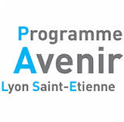
Overview of Task T3 of the LiveMusic project
Mathieu VEYRAND
under the supervision of
Hassan Aït-Kaci

Slide 2
This presentation overviews the contents of Task T3 of the LivEMUSIC Project: "Use of Ontological Knowledge for Monitoring Applications"
This constitutes essentially the work of Mathieu VEYRAND following the specifications of Professor Hassan Aït-Kaci (june 2015 - october 2015)
The LivEMUSIC project was funded as a PALSE (Programme Avenir Lyon Saint-Etienne)

Slide 3
Input files
Data from Grand Lyon, extracted by Tanguy Raynaud (Task T1)
Velo'v stations is chosen as the first dataset
348 objects - 18 attributes
Raw data in JSON - for ex:

Slide 4
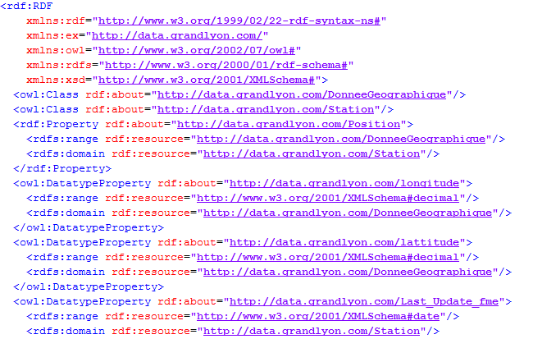
RDF Schema
The raw data is converted into a RDF Schema, which is latter used to make SPARQL queries

Slide 5
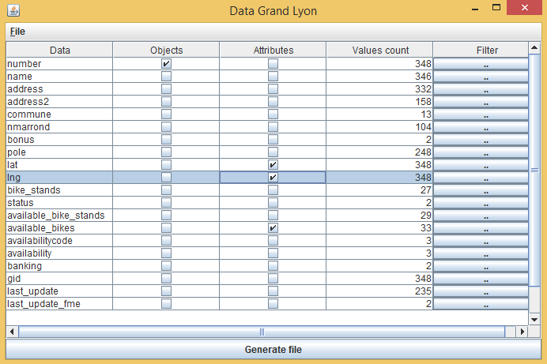
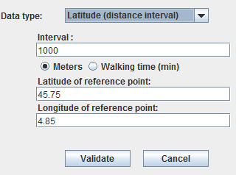
Semantic Zoom
Master Degree's internship of Sofiene CHAMAKHI (Task T2)
"Semantic Zoom": specify approximation on data and use to query

Slide 6
Supported Zooms
Numerical Data
Interval ([0-10[ [10-20[ …)
Difference (V +- d)
Threshold (>,<,= T)
Geographical Data
Interval
Difference
Date
Interval
Difference

Slide 7
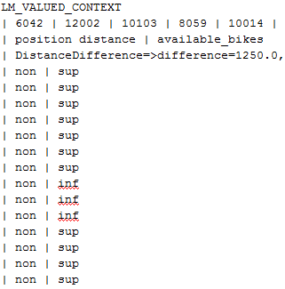
.lmvt file
Format used by Lattice Miner
Represents a multi-valued concept lattice

Slide 8
Lattice Miner
Open source software for visualization and manipulation of concept lattices
Used to convert the multi-valued lattice into a binary lattice
Modification of the source code to convert the lattice into a format supported by CEDAR
A Concept-Station correspondance file is also generated

Slide 9
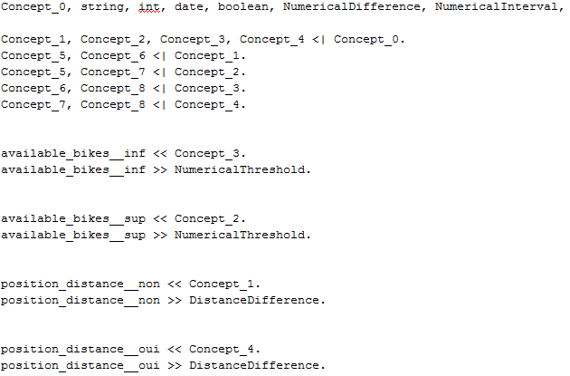
.osf file
Representation of the concept lattice supported by CEDAR

Slide 10
Concept - Station correspondance
Plain text file used to retrieve each station associated with one concept

Slide 11
CEDAR Reasoner
Software developed by Hassan Aït-Kaci and Samir Amir
Used to find the concept matching our criteria
Then the correspondance file is used to retrieve the stations

Slide 12
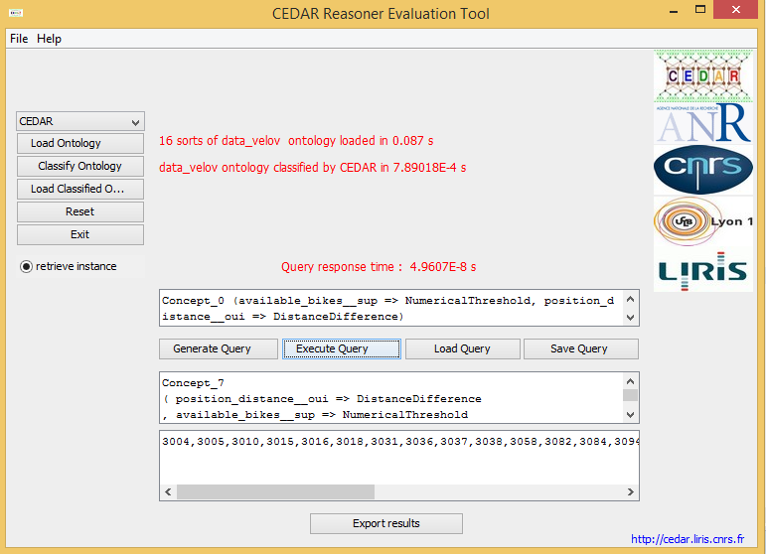

Slide 13
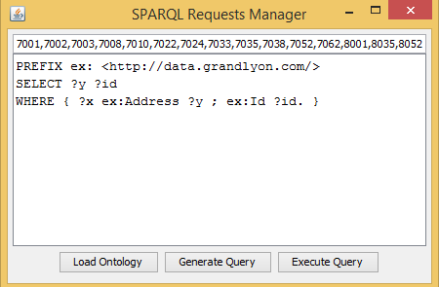
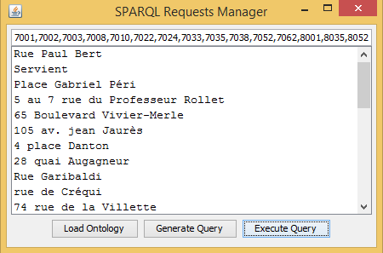
SPARQL Queries
GUI to make SPARQL queries
Easy filter on IDs

Slide 14
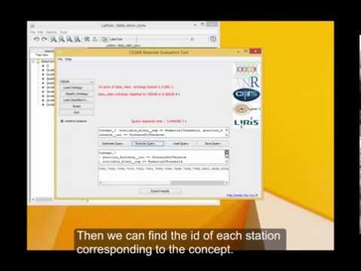
Demo video available at: https://youtu.be/nM3dDy74qIw

